Slide 1

Monetary Policy and
Fiscal Policy
Syed A. Mamun, PhD, FCMA
Professor of Finance & Strategy
Department of ESS
BRAC University

Slide 2
Quantity Theory of Money
The Quantity Theory of Money (QTM) explains the relationship between the money supply, price level, and real output in an economy.
If the money supply grows faster than
  real output, the general price level tends to rise,
  causing inflation.

Slide 3
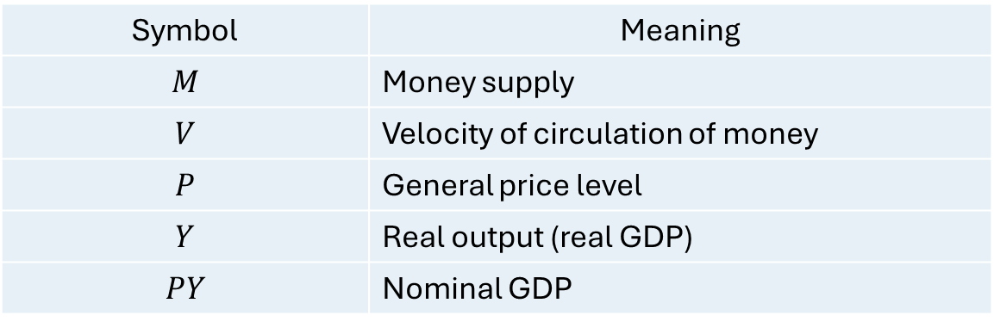
Quantity Theory of Money
The theory is expressed through the equation:
MV=PY​
Symbol | Meaning
$$M$$ | Money supply
$$V$$ | Velocity of circulation of money
$$P$$ | General price level
$$Y$$ | Real output (real GDP)
$$PY$$ | Nominal GDP
Money Supply × Velocity = Price Level × Real Output

Slide 4

What is Velocity of Money?
Velocity ($V$) measures how many times, on average, a unit of money is used to purchase final goods and services during a period.
V=PY​​/ M
Example
Suppose, Money supply = Tk. 1,000 billion and Nominal GDP (PY) = Tk. 10,000 billion
Then, $V=\frac{10,000}{1,000}=10$
This means each taka is used, on average, 10 times to support transactions represented in nominal GDP.

Slide 5

Classical Quantity Theory
Assumption 1: Velocity is stable
  $V=\text{constant}$
Assumption 2: Real output is determined by real factors
  In the long run, $Y$is determined by factors such as:
    Labour
    Capital
    Technology
    Natural resources
    Productivity
Therefore, changes in $M$mainly affect $P$.
  Starting with: $MV=PY$
  If $V$and $Y$are constant: $M↑⇒P↑$
Therefore:
  Money supply growth → Inflation​

Slide 6

Macroeconomic Policy Framework
Macroeconomic policy refers to government actions designed to influence the overall performance of an economy.
The major goals are:
  Economic growth
  Price stability
  Full employment
  Balance of payments/external stability
  Financial stability
  Exchange-rate stability, where relevant
Two major instruments are:
  Monetary Policy → Central Bank
  Fiscal Policy → Government

Slide 7
Monetary Policy
Monetary policy is the use of monetary and financial instruments by a central bank to influence:
  Money supply
  Interest rates
  Credit conditions
  Inflation
  Aggregate demand
  Exchange-rate and financial conditions
The ultimate objective is generally to maintain price and macroeconomic stability while supporting sustainable economic growth.

Slide 8
Who Conducts Monetary Policy?
The central bank is responsible for monetary policy.
For Bangladesh: Bangladesh Bank
Bangladesh Bank influences economic activity through:
Policy interest rates
Open market operations
Reserve requirements
Liquidity management
Foreign-exchange operations
Other monetary and macroprudential instruments

Slide 9
Objectives of Monetary Policy
Price Stability and controlling Inflation
Economic Growth
Employment generation
Financial Stability
Banking system
Credit markets
Payment systems
Financial markets
External stability
Exchange rate
Capital flows
Foreign-exchange demand
Balance of payments

Slide 10
Two types of Monetary Policy
Expansionary Monetary Policy
Contractionary Monetary Policy

Slide 11
Expansionary Monetary Policy
Expansionary monetary policy is used when the economy is weak or aggregate demand is insufficient.
Money/credit conditions ↑
→ Interest rate ↓
→ Investment ↑
→ Consumption ↑
→ AD ↑
→ Real GDP ↑
→ Employment ↑
Potential problem:
→ Inflation ↑

Slide 12
Contractionary Monetary Policy
Contractionary monetary policy is used when inflationary pressure is excessive.
Mechanism
  Money/credit conditions ↓
  → Interest rate ↑
  → Investment ↓
  → Consumption ↓
  → AD ↓
  → Inflation ↓
But:
  → Economic growth may slow.

Slide 13

Monetary Policy Instruments
Policy Interest Rate
The central bank changes its policy rate to influence market interest rates.
Reserve Requirement
Commercial banks are required to maintain specified reserves.
Open Market Operations
The central bank can buy or sell securities.

Slide 14
Fiscal Policy
Fiscal policy refers to government decisions regarding:
  Government expenditure (G)
  Taxation (T)
  Government transfers
to influence economic activity.
  Aggregate demand
  Output
  Employment
  Inflation
  Income distribution
  Economic growth

Slide 15
Components of Fiscal Policy
Government expenditure can include:
Current expenditure
  Salaries
  Administration
  Subsidies
  Interest payments
Development expenditure
  Roads
  Bridges
  Infrastructure
  Education
  Health
  Energy
  Digital infrastructure

Slide 16
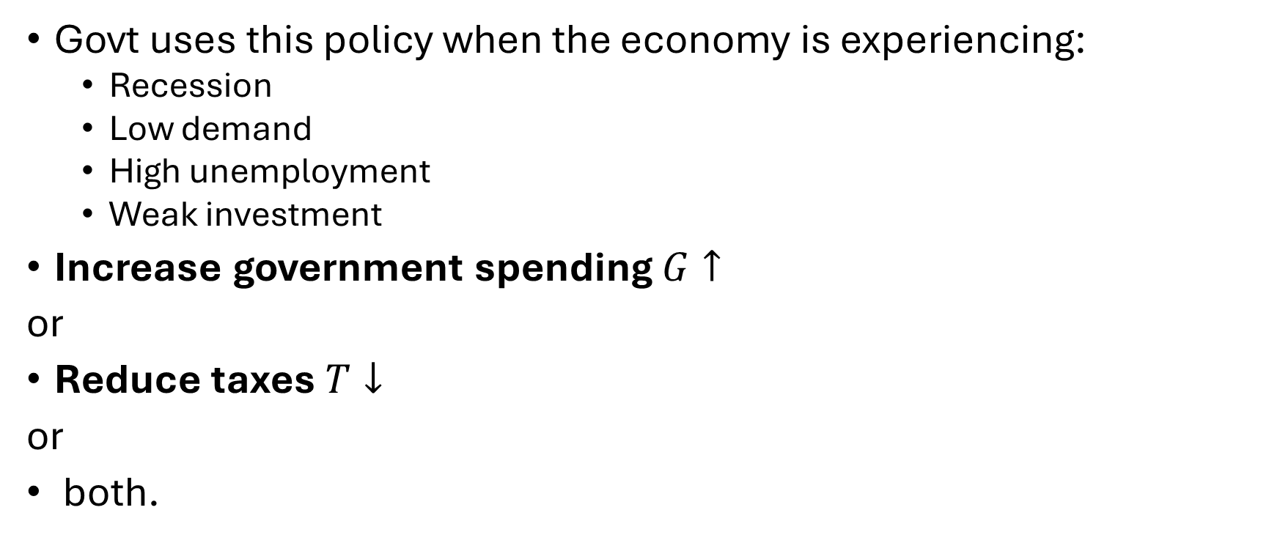
Expansionary Fiscal Policy
Govt uses this policy when the economy is experiencing:
  Recession
  Low demand
  High unemployment
  Weak investment
Increase government spending $G↑$
or
Reduce taxes $T↓$
or
both.

Slide 17
Contractionary Fiscal Policy
Used when inflationary pressure is excessive.
Government can:
  Reduce government expenditure
  Increase taxes
  Reduce transfers

